Slide 1
Machine Learning in Predicting Future Stock Prices
Presented by:
A0239184X Chen Fei
A0234591A Leo Zhen Yu, Melvin
A0244853Y Jirawan Tritham
A0258995B Ryan Toh
A0252335L Kealan Kuar
A0252515L Teo Jing Kiat
Notes:
Hi everyone, my name is chen fei, and today my team and i will be presenting our solution for stock price prediction

Slide 2
Table of contents
01
02
03
04
05
06
Introduction
Dataset cleaning
Feature Engineering and Selection
Models used
Hyperparameter Tuning
Evaluation and Recommendation
Notes:
Here is table of contents, and without further ado

Slide 3
01
Introduction
Notes:
Lets get into the goals of the project

Slide 4
Goals of the project
Develop a machine-learning model capable of predicting future stock prices across different industries
The model will be trained on stocks from specific industries, and we will explore different modelling methods, from time series to linear models
The model will be easily understandable for the average person, and will aim for a high level of accuracy in predicting general next-day returns in industries of the user’s choice
Accurately predicting future market movements is crucial for making data-driven decisions, minimising risk, and optimising investment strategies
Notes:
In this project, we would like to develop a machine learning model to help the average person predict stock prices in an industry of their choice. The model should be generalised enough to learn the trends of different industries, and it will be easy for a person from a non-finance background to understand, so that they can have a tool to do a general prediction of whether or not stock prices increase.

Slide 5
02
Dataset
Cleaning
Notes:
Ill now briefly explain how our team cleaned the dataset

Slide 6
a. Slicing of dataset via Info_tech and Fin
Filered to get the top 500 companies
Tickers acquired from sp500.csv
Filtered to get Infotech and Fin companies
Sliced via the ‘Sector’ column
8000+ companies
500 companies
Info Tech Companies: 71
Finance Companies: 66
Notes:
Initially, We started with over 8,000 companies and filtered it down to the top 500 based on the tickers listed in the SP500 dataset. We decided to group stocks that were more related to one another by selecting only the InfoTech and Finance companies using the 'Sector' column. This resulted in 71 InfoTech companies and 66 Finance companies, creating two distinct datasets for focused analysis.

Slide 7
b. Removal and propagation of features
1. OpenInt
Redundant feature
More helpful when being used to predict derivatives like options and futures
2. Days that had more than 10% of zero volume days
We needed consistent trading activity to train a reliable model for next-day stock prices.
Stocks with a high number of zero-volume days may have introduced noise, thus decreasing model accuracy.
3. Stocks that had 0 values in their open, close or volume
Backfilled, or in some cases, removed such values
Stocks with zero percentage made up less than 1% of the total number of data points for each stock, and only the “volume” column had 0 values
We decided to forward fill the 0 values using the previous day's volume, instead of removing them, so that we could keep all the data for the time series analysis.
Notes:
We then did removal and propagation of features
Firstly, We removed OpenInt as it was redundant for our analysis and more relevant for predicting derivatives like options and futures.
Next, Stocks with more than 10% of zero-volume days were excluded to ensure consistent trading activity and prevent noise from affecting model accuracy.
For stocks with zero values in the 'Open,' 'Close,' or 'Volume' columns, we backfilled these values using the previous day's data. Since zero values accounted for less than 1% of total data points and were primarily in the 'Volume' column, this approach allowed us to retain the time series continuity while avoiding data loss.

Slide 8
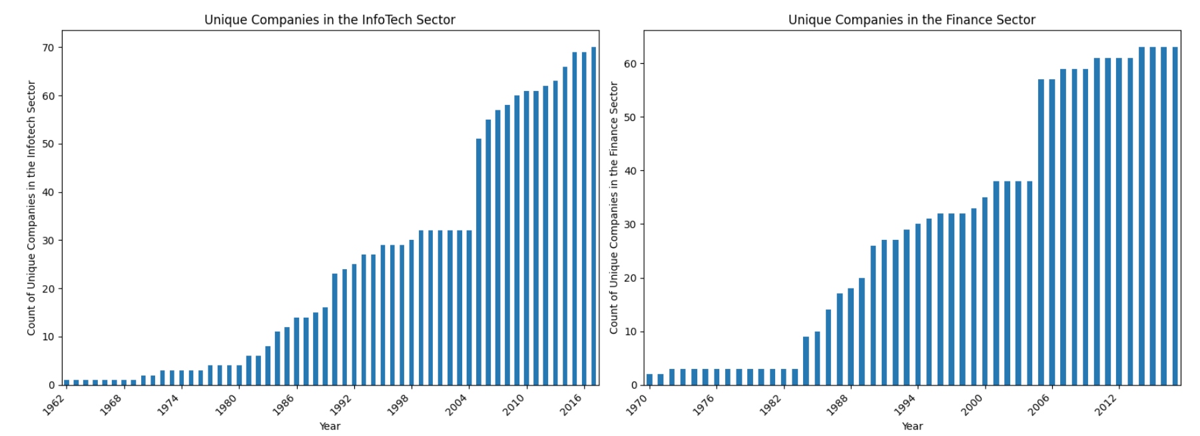
b. Removal and propagation of features
4. Splitting the date column into quarter, month and day
Quarters and months are more helpful in stock prediction, compared to the year, as stocks often exhibit seasonal patterns (eg. Christmas season leading to better performance in Q4)
Day of the week also affects the stock market as traders tend to close positions on friday before the weekend.
5. Removal of pre-2005 years
There is a disproportionate amount of data in the years after 2005, as seen in the diagram.
Could potentially introduce bias, and skew the model if the time periods don't represent
current market conditions or trends.
Also irrelevant to current market conditions.
6. Ensuring stocks had data for the entire time period of 2010-2017
To end up with a balanced dataset.
Notes:
We split the date column into quarters, months, and days as they are more useful for stock prediction due to seasonal patterns like better performance during the Christmas season in Q4. Additionally, the day of the week impacts stock trading as traders tend to close positions before weekends.
We also removed pre-2005 data as it was disproportionately represented in our dataset and irrelevant to current market trends. Keeping it could have introduced bias and skewed the model, as shown in the diagram.
Lastly, we ensured that stocks had data for the entire time period of 2010–2017, which provided a balanced dataset for reliable analysis.
Ill now pass the time on to ryan.

Slide 9
c. Volume-Weighted Metrics
Stocks in the portfolio are weighted by trading volume
This approximates market influence by emphasizing stocks with higher trading activity through their trading volume, addressing the absence of market capitalization data
Offers a more precise aggregated metric compared to simple averaging, which assumes all stocks hold equal significance regardless of their trading activity or market influence.
We acknowledge that volume weighting may not fully reflect a company's true size or long-term market influence, as high trading volumes can sometimes result from short-term spikes or anomalous market activity.
Notes:
Thank you Chen Fei. We also implemented volume-weighted metrics because we understand that not all companies influence the S&P 500 equally. Larger or more actively traded companies typically have a greater impact on market movements. We chose to use trading volume as a practical alternative to approximate each stock’s relative market influence. Compared to simple averaging, which assigns equal importance to all stocks, volume weighting reduces bias by emphasizing stocks that truly drive market activity

Slide 10
d. Aggregation of individual stocks
We made the assumption that stocks in SMP500 would have similar trends
As we only intend to model high level trends of the top stocks, we aggregated individual stock data into portfolio-level features
This approach mitigates multicollinearity, lowers overfitting risk, and enhances model interpretability by focusing on macro trends.
Notes:
Lastly , we assumed that stocks within the S&P 500 exhibit similar trends due to shared macroeconomic factors, industry dynamics and investor behavior. This assumption allowed us to aggregate individual stock data into hportfolio-level features, enabling us to model high-level market trends rather than focusing on individual stock movements. Aggregating data in this way mitigates multicollinearity and reduces redundancy in the data. It also lowers the risk of overfitting by simplifying the model and avoiding noise from stock-specific fluctuations.

Slide 11
03
Feature engineering and selection
Notes:
I will now talk about the feature engineering and feature selection process

Slide 12
Five features added in total
1. Moving Averages | 2. Volatility | 3. Volume Moving Average
5-day and 10-day moving averages based on the Close price for each stock/ETF Helps the model detect short-term and medium-term momentum, indicating whether the stock is in an upward or downward trend. | The percentage difference between the High and Low prices for each day. High volatility often leads to larger price swings, helping the model gauge the likelihood of significant upward or downward moves. | 5-day moving average of the Volume Volume spikes often confirm trends, helping the model strengthen predictions when combined with price changes.
Notes:
This slide covers the first three features added. Moving averages (5-day and 10-day) capture short and medium-term momentum, identifying trends. Volatility measures daily price swings, helping the model predict significant movements. Finally, the volume moving average confirms trends by analyzing 5-day trading volume spikes alongside price changes.

Slide 13
Five features added in total
4. Relative Strength Index (RSI) | 5. Moving Average Convergence Divergence (MACD)
Measures recent price changes to identify overbought (above 70) or oversold (below 30) conditions in stocks An RSI above 70 can signal that a stock is overbought and may face a downward correction, while an RSI below 30 suggests it is oversold and might see a rebound. Traders use RSI alongside other indicators to predict potential trend reversals and confirm price momentum. | The relationship between two moving averages of a stock's price, typically the 12-day and 26-day exponential moving averages MACD is useful for predicting stock momentum, as it signals potential trend reversals and market momentum shifts when divergences or crossovers occur
Notes:
The last two features added are RSI and MACD. RSI identifies overbought or oversold conditions, signaling potential corrections or rebounds. MACD analyzes the relationship between two moving averages, providing key insights into momentum shifts and trend reversals.

Slide 14
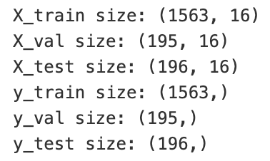
Splitting the dataset before applying feature selection
Before feature selection, we first split the dataset into training, validation, and testing data set
We split the time series data chronologically to preserve the natural order of events, ensuring the training set uses past data to predict future outcomes.
This approach avoids data leakage and better reflects real-world scenarios where future data is unavailable during model training.
Notes:
Then, We split the dataset into training, validation, and testing sets before applying feature selection. To preserve the natural order of events, we split the time series data chronologically, ensuring the training set uses only past data to predict future outcomes. This approach avoids data leakage and mimics real-world scenarios where future data isn't available during model training. I will now hand over the time to Jing Kiat.

Slide 15
Feature selection methods used
1. Lasso | 2. XGBoost | 3. Principal Component Analysis (PCA)
Uses L1 regularization to shrink coefficients of less important features to zero. | Uses tree-based feature importance to rank and select the most relevant features based on their contribution to reducing prediction error. | Transforms data into a set of uncorrelated components, prioritizing those that capture the most variance in the dataset.
Notes:
Thank You Ryan. We used mainly three feature selection methods, as shown in the slide above, to select optimal features for our models.

Slide 16
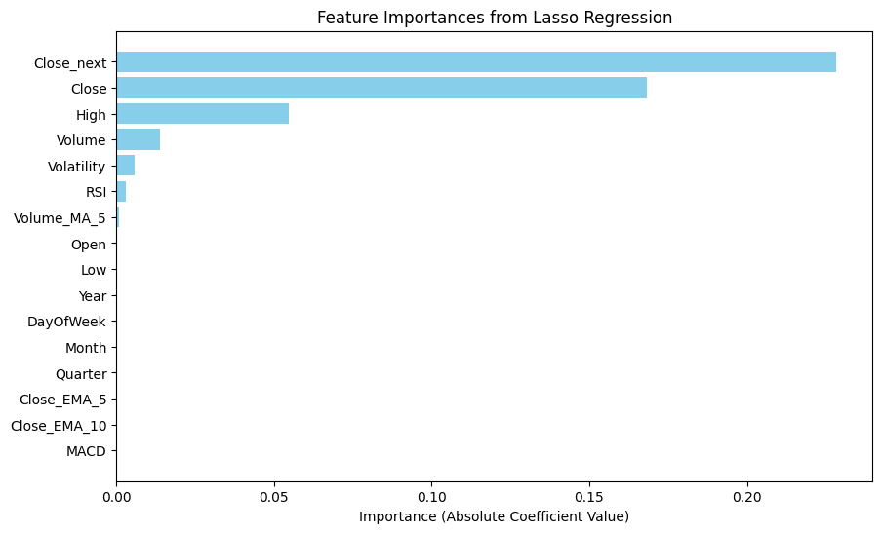
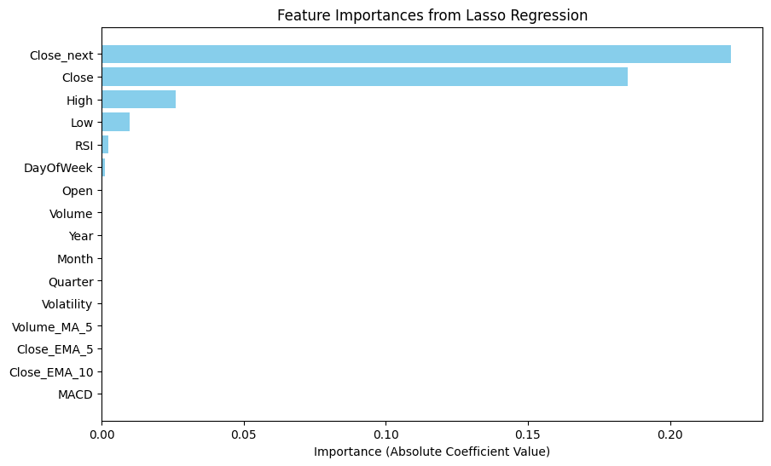
Feature Selection: Lasso
Hyperparameter tuning resulted in an optimal alpha of 0.01
Finance:
Mean Squared Error (MSE) with Lasso on original features: 0.0001437
Selected features by Lasso: 'High', 'Close', 'Volume', 'Volatility', 'Volume_MA_5', 'RSI', 'Close_next'
InfoTech:
Mean Squared Error (MSE) with Lasso on original features: 0.0001615
Selected features by Lasso:
'High', 'Low', 'Close', 'DayOfWeek', 'RSI', 'Close_next'
Notes:
For Lasso feature selection, we tuned the hyperparameter and found an optimal alpha value of 0.01. In the Finance dataset, Lasso reduced the features to key variables like 'High,' 'Low,' 'Close,' and 'Volatility,' achieving a mean squared error of 0.0001437. Similarly, in the InfoTech dataset, it selected features like 'High,' 'Low,' 'Volume,' and 'RSI,' with a mean squared error of 0.0001615. This demonstrates how Lasso effectively removes less significant features while maintaining performance.

Slide 17
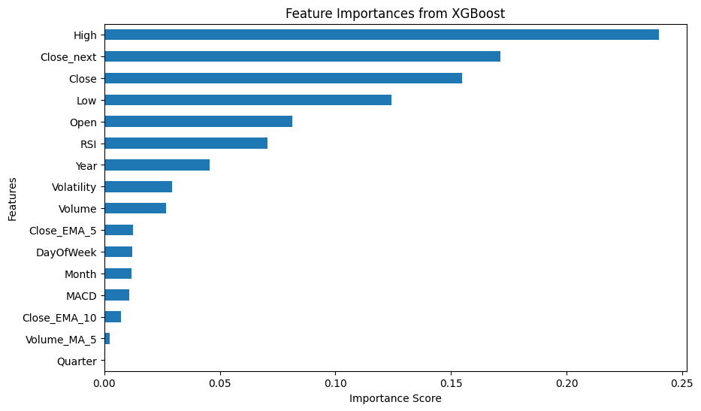
Feature Selection: XGBoost
Finance:
List of features, sorted by importance:
High 0.239955
Close_next 0.171325
Close 0.154633
Low 0.124375
Open 0.081273
RSI 0.070674
Year 0.045664
Volatility 0.029269
Volume 0.026656
Close_EMA_5 0.012482
DayOfWeek 0.012161
Month 0.011580
MACD 0.010608
Close_EMA_10 0.007055
Volume_MA_5 0.002289
Quarter 0.000000
Threshold > 0.05
Features chosen: ‘High', 'Close_next', 'Close', 'Low', 'Open', 'RSI'
Notes:
For the Finance dataset, feature selection was based on feature importance scores from the XGBoostmodel. Using a threshold of 0.05, the top features chosen were ‘High’ , ‘Close_next’ ‘Close’ “low’ ‘Open’ ‘RSI’ Among these, 'High' contributed the most with an importance score of 0.2399. This method ensures that only features with significant predictive power are included, simplifying the model without compromising accuracy.

Slide 18
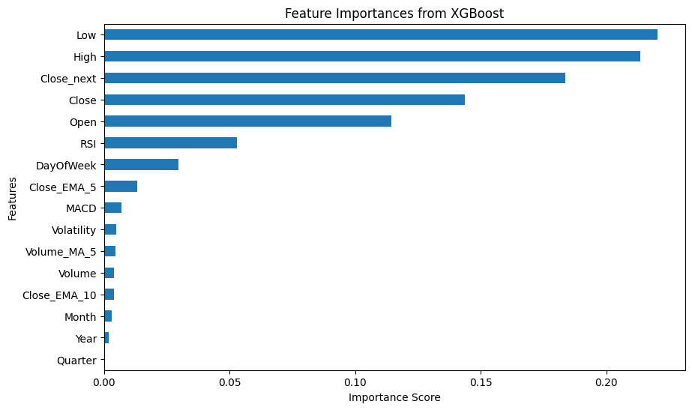
Feature Selection: XGBoost
InfoTech:
List of features, sorted by importance:
Low 0.220373
High 0.213362
Close_next 0.183771
Close 0.143666
Open 0.114523
RSI 0.052927
DayOfWeek 0.029583
Close_EMA_5 0.013106
MACD 0.006753
Volatility 0.004943
Volume_MA_5 0.004429
Volume 0.003841
Close_EMA_10 0.003811
Month 0.003056
Year 0.001857
Quarter 0.000000
Threshold > 0.05
Features chosen: 'Low', 'High', 'Close_next', 'Close', 'Open', 'RSI'
Notes:
For the InfoTech dataset, XGBoost ranked features by importance, selecting those above a threshold of 0.05.'Low' contributed the most with an importance score of 0.22. This method ensured that only the most influential features were retained for accurate predictions.

Slide 19
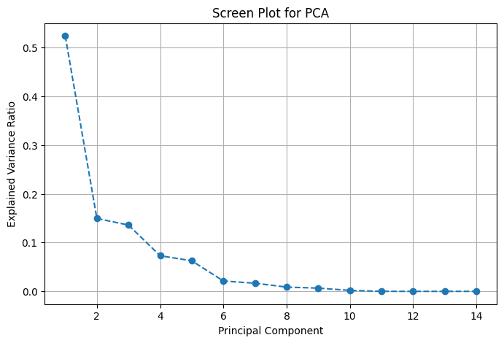
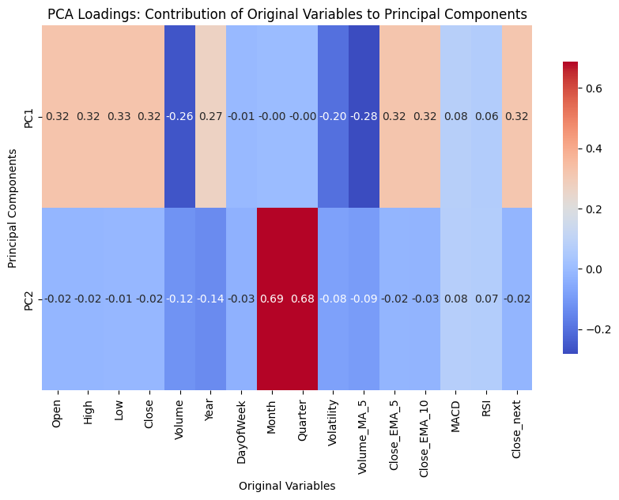
Feature Selection: Principal Component Analysis (PCA)
Screen plot revealed an elbow at 2 components, indicating that 2 was the optimal number of principal components
The new principal components greatly reduced redundancy and maximised variance
Notes:
Lastly, for PCA, the optimal number of principal components is two, as seen from the screen plot. It can also be seen that the new principal components greatly reduced redundancy and maximised variance

Slide 20
Defining target variable
Our target variable is "close_next", which represents the percentage change between the current day’s closing price and the following day’s closing price.
Aligns perfectly with short term strategies allowing us to focus on directional trends
Crucial for decision making as it provides clear signals to guide short-term trading strategies.
Reduces collinearity between features
Notes:
For our target variable for this project is ‘close_next’ which represents the percentage change between a stock’s closing price on the current day and its closing price for the following day. We chose this variable because it aligns perfectly with short-term strategies such as daily rebalancing or trading decision where timely and actionable insights are critical.
Additionally, this approach reduces collinearity between features as percentage changes minimize the dependencies that often arise when using raw price values.
next, I'll pass the time to kealan to talk more about the models used in the project.

Slide 21
04
Models used

Slide 22
a. Linear Regression
Linear regression is a simple and interpretable model that assumes a linear relationship between the independent variables and the target variable.
It was chosen as our baseline model because it is computationally efficient and provides a straightforward way to analyze relationships between variables, making it a good starting point for stock price prediction.
We acknowledge that linear regression has significant limitations for stock prediction. It assumes a constant linear relationship, which oversimplifies the complex, dynamic, and non-linear patterns present in stock market data.
Linear regression can predict general trends but struggles to account for sudden shifts or non-linear patterns. It also assumes relationships between variables remain constant over time, which is often unrealistic in volatile markets.
For our data, the non-linear yearly increase in stock prices limited linear regression accuracy in predicting future values.
Notes:
First, Linear regression is a simple and interpretable model that assumes a linear relationship between the features and the target variable. We chose it as our baseline model because it is computationally efficient and provides a straightforward way to analyze relationships, making it a great starting point for stock price prediction. However, linear regression has significant limitations for this task. It assumes a constant linear relationship, which oversimplifies the dynamic and non-linear nature of stock market data. While it can predict general trends, it struggles with sudden shifts, non-linear patterns, and the assumption that relationships between variables remain constant over time.
In our dataset, the non-linear yearly increase in stock prices highlighted these limitations. Linear regression captured basic trends but lacked the accuracy needed for more complex predictions.

Slide 23
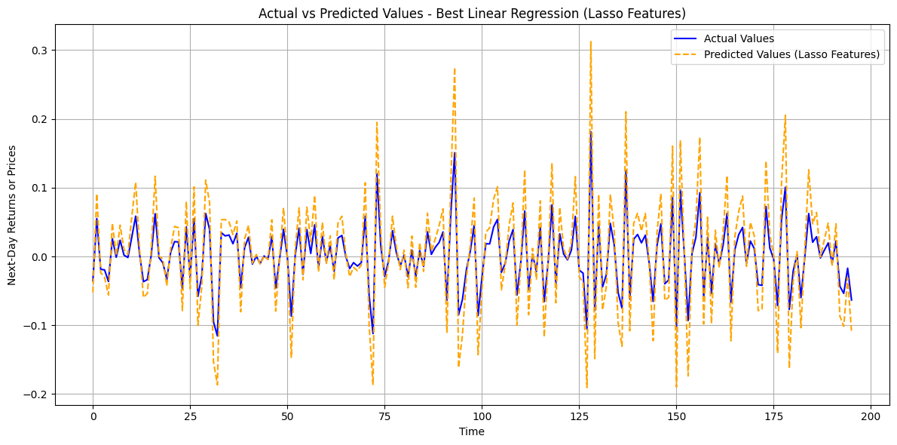
Best Performing Linear Regression Model (Finance Stocks)
Best Feature Set: Lasso Features
Best MAE: 0.0294
Best MSE: 0.0015 Best RMSE: 0.0382
Notes:
We compares different regression techniques for stock prediction. Lasso feature selection was chosen as it achieved the lowest MSE for both finance and info tech stocks

Slide 24
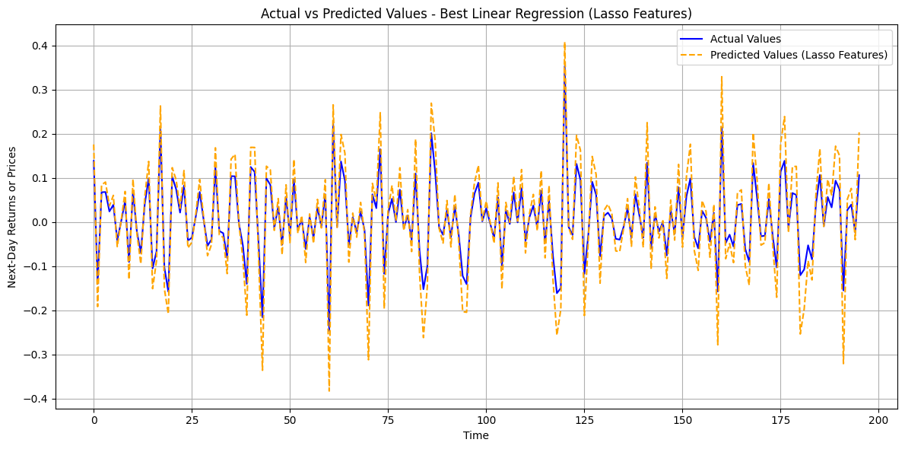
Best Performing Linear Regression Model (InfoTech Stocks)
Best Feature Set: Lasso Features
Best MAE: 0.0364
Best MSE: 0.0022
Best RMSE: 0.0470
Notes:
We compares different regression techniques for stock prediction. Lasso feature selection was chosen as it achieved the lowest MSE.

Slide 25
b. Extreme Gradient Boosting (XGBoost)
We chose XGBoost as our next model as it can model non-linear relationships and seasonality effectively, making it suitable for capturing complex temporal patterns.
However, we acknowledge that XGBoost is not inherently designed for extrapolation (predicting values beyond the range of the training data). It is meant for interpolation, capturing patterns within the range of observed data.
We also acknowledge that stock returns are volatile and influenced by many unpredictable factors which could result in large fluctuations in the results.
Notes:
Next, we used XGBoost which uses gradient-boosted decision trees to model complex patterns in structured data. We chose XGBoost because it excels at capturing non-linear relationships and seasonality, making it suitable for stock price trends.
However, XGboost is not designed for extrapolation meaning it struggles to predict values beyond the training range. Instead, it excels at interpolation, identifying patterns within the observed data.
We also acknowledge that stock returns, particularly short-term returns are volatile and influenced by many unpredictable factors which could result in large fluctuations in the results.

Slide 26
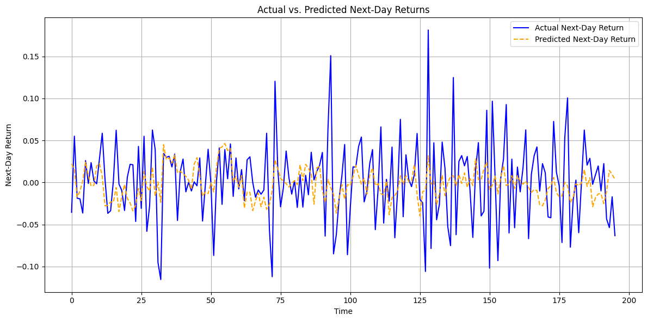
Best Performing XGBoost Model (Finance Stocks)
Best Feature Set: Lasso Features
Best MAE: 0.0340
Best MSE: 0.0020 Best RMSE: 0.0449
Notes:
Here we provide a visual representation of the fluctuations in XGBoost predictions (in blue) compared to actual values (in orange)
Here we chose Lasso features as it performed the best for the XGBoost model.

Slide 27
Best Performing XGBoost Model (InfoTech Stocks)
Best Feature Set: XGBoost Features
Best MAE: 0.0444
Best MSE: 0.0037 Best RMSE: 0.0608
Notes:
Here we provide a visual representation of the fluctuations in XGBoost predictions (in blue) compared to actual values (in orange)
Here we chose XGBoost features as it performed the best for the XGBoost model.

Slide 28
c. Long Short-Term Memory (LSTM)
LSTM is a type of recurrent neural network (RNN) designed to remember long-term dependencies by using gates to control the flow of information, making it useful for sequential data like time series or natural language.
Unlike standard RNNs, LSTMs mitigate the vanishing gradient problem, allowing them to learn from data patterns over longer sequences.
They are effective for stock prediction as they excel in handling sequential data, making them well-suited for time series analysis, where past prices and trends significantly impact future predictions.
We first ran LSTM on raw data, with no feature engineering, before applying each set of engineered data on the model.
Notes:
Next, we’ll discuss LSTM (Long Short-Term Memory), a type of recurrent neural network designed for sequential data like time series or natural language. Unlike standard RNNs, LSTMs address the vanishing gradient problem, enabling them to capture patterns over longer sequences.
This makes them ideal for stock prediction, as they excel at identifying sequential dependencies where past trends influence future values. For our analysis, we fine-tuned hyperparameters by testing various feature selection methods and choosing the best-performing configuration.

Slide 29
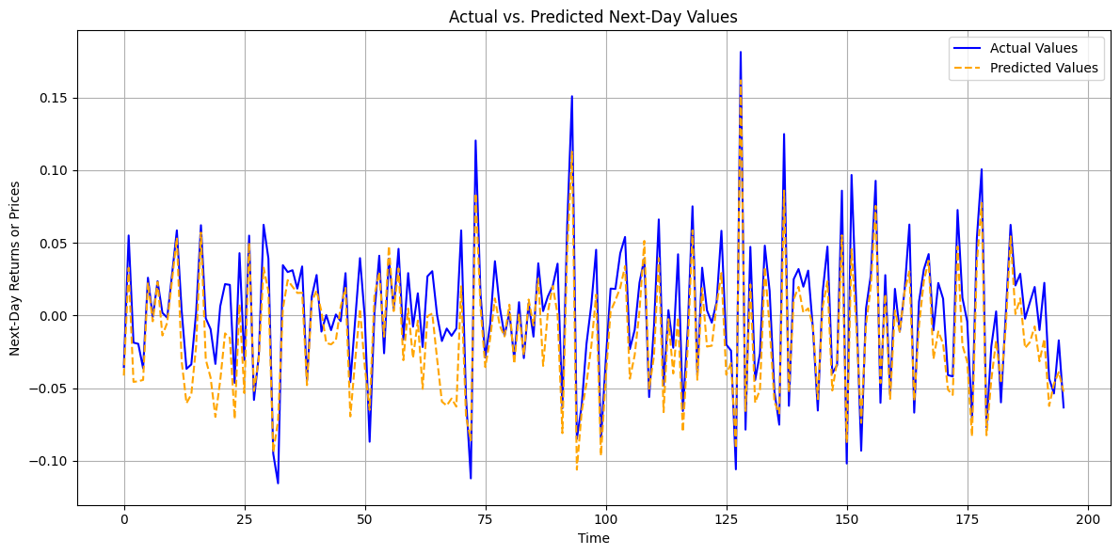
Best Performing LSTM Model (Finance Stocks)
Best Feature Set: XGBoost Features
Best MAE: 0.0200
Best MSE: 0.0006
Best RMSE: 0.0243
Notes:
We selected XGBoost for our finance stock data analysis because it achieved the lowest RMSE, demonstrating superior performance compared to other models. Its ability to accurately capture trends and minimize prediction errors made it the most reliable choice for forecasting stock prices.

Slide 30
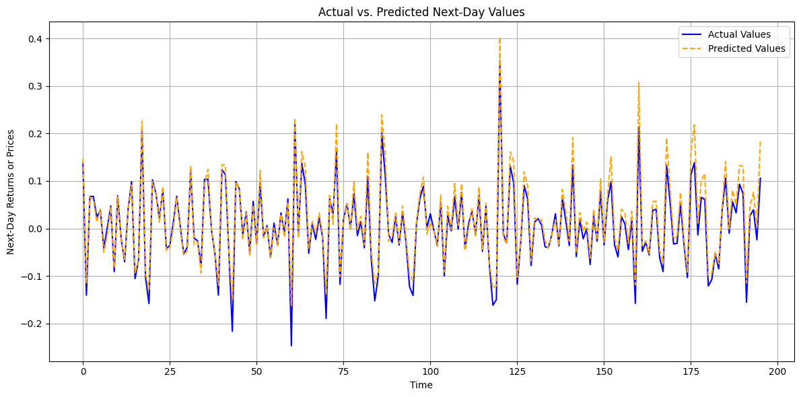
Best Performing LSTM Model (InfoTech Stocks)
Best Feature Set: XGBoost Features
Best MAE: 0.0305
Best MSE: 0.0012
Best RMSE: 0.0348
Notes:
Building on our analysis of financial stocks with XGBoost, we found that for InfoTech stocks, Lasso regression delivered the most accurate results, achieving the lowest RMSE.

Slide 31
05
Hyperparameter Tuning
Notes:
Next, we’re move on to how we did hyper parameter tuning for our models

Slide 32
a. GridSesarch for Lasso
For Hyperparameter Tuning, we used Grid Search for Lasso to systematically evaluate all possible combinations of hyperparameters.
It works by exhaustively searching over a predefined grid of hyperparameter values. Each combination is evaluated using time-series cross-validation, and the one with the best performance is selected.
This resulted in the optimal hyperparameters, as shown below: Best Hyperparameter: {'alpha': 0.001}
Notes:
We applied hyperparameter tuning with Lasso for InfoTech stock prediction by using GridSearchCV with TimeSeriesSplit to maintain the temporal structure. Standardizing the features with StandardScaler, we tested various alpha values and identified the best-performing parameter {alpha} to minimize RMSE, ensuring accurate feature selection and improved predictions

Slide 33
b. Randomized search for XGBoost
For Hyperparameter Tuning, we did Randomized Search for XGBoost as it was less computationally expensive.
It works by randomly sampling a fixed number of hyperparameter combinations from a defined search space. Each combination is evaluated using cross-validation and the one with the best performance is selected.
This resulted in the optimal hyperparameters, as shown below:
Best Hyperparameters: {'subsample': 0.8, 'reg_lambda': 2, 'reg_alpha': 0.01, 'n_estimators': 200, 'min_child_weight': 1, 'max_depth': 5, 'learning_rate': 0.2, 'gamma': 0, 'colsample_bytree': 1.0}
Notes:
We employed RandomizedSearchCV to optimise the hyperparameters of the XGBoost model. Allowing us to efficiently explore a large hyperparameter space by randomly sampling a fixed number of parameter combinations. This ensured that the XGBoost model was both efficient and robust as well as achieving a reduced RMSE.

Slide 34
c. GridSearch for LSTM
Used Keras Tuner with RandomSearch to optimise the LSTM model tuning parameters such as LSTM units, Dropout rates and Learning rates.
Designed to efficiently optimise hyperparameters specific to neural networks.
Simplifies the tuning of complex architectures like LSTMs
Achieved optimised results with the tuned LSTM model
Notes:
We used Keras Tuner for hyperparameter tuning. It is a tool purpose-built for optimising neural network configurations. Its design makes it particularly effective for tuning complex models like LSTM. For this project, we implemented RandomSearch to explore combinations of key hyperparameters. The result was a well-optimized LSTM model with improved validation loss and a lower Test MAE, showcasing the value of Keras Tuner in achieving optimal neural network performance.

Slide 35
06
Evaluation + Results
Notes:
Now let’s move on into the final section of our presentation, the evaluation and results

Slide 36
Evaluation of models
We made use of RMSE and MAE as a comparison between best performing models
XGBOOST and LINEAR REGRESSION:
RMSE penalizes large errors more heavily, making it suitable for models that aim to minimize large deviations. XGBoost and Linear Regression are regression-based models where RMSE helps evaluate how well the model fits the data overall, capturing both small and large errors effectively.
LSTM:
Test MAE which aligns with how sequential models handle errors, focusing on average error magnitudes without over-penalizing large outliers.
Notes:
Here, we used two different evaluation metrics, RMSE and MAE, to compare the performance of XGBoost, Linear Regression, and LSTM models. RMSE helped assess overall fit by penalizing large errors, while MAE is suited to measure LSTM's ability to handle sequential data and average errors effectively.

Slide 37
Evaluation of models
The results reflect the graphs in the section above, where LSTM was the best performing model, and Linear Regression and XGBoost lagged behind.
We thus conclude that we managed to create a generalized model that can be used to model industry trends
Finance:
Infotech:
Model | Linear Regression | XGBoost | LSTM
Test loss (MSE) | 0.0015 | 0.0020 | 0.0006
Test MAE | 0.0294 | 0.0340 | 0.0200
RMSE | 0.0382 | 0.0449 | 0.0243
Model | Linear Regression | XGBoost | LSTM
Test loss (MSE) | 0.0022 | 0.0037 | 0.0012
Test MAE | 0.0364 | 0.0444 | 0.0305
RMSE | 0.0470 | 0.0608 | 0.0348
Notes:
Based on three metrics results, we conclude that LSTM is the best choice for creating a general trend model that can be used across industries. Its superior performance and flexibility highlight its potential for analysing temporal data and could even be used for applications beyond stock price predictions

Slide 38
Recommendation: LSTM with XGBoost feature selection
Why LSTM?
-LSTM achieved the lowest MAE and RMSE scores which demonstrates superior accuracy and reliability compared to other models
-Our analysis revealed that feature selection methods impact model performance differently across industries
-Tailoring feature selection to industry characteristics enhances prediction accuracy, and LSTM consistently outperformed other models across most scenarios.
Notes:
We conducted rigorous evaluations of multiple models using metrics like MAE and RMSE to ensure accuracy and interpretability. Among all tested models, LSTM with XGBoost feature selection provided the most reliable predictions, achieving the lowest error rates.
Furthermore, we discovered that different industries benefit from distinct feature selection approaches. In industries other than Finance and Info-Tech, other feature selection methods might perform better when combined with LSTM.
These findings highlight the importance of customizing feature engineering to industry-specific characteristics for optimal prediction.

Slide 39
Are there ideas on how to further improve your model?
Recalibrate the models using market cap weights to improve alignment with real-world index performance and enhance prediction accuracy.
Experiment with different ensembling techniques
Experiment with combining activation functions to improve convergence and model accuracy
Notes:
Our current model uses trading volume to weight stocks, while it captures trading activity it does not fully reflect the size or importance of each stock. Using market cap instead provides a more accurate representation of each stock’s value within the market. However, we didn't have access to historical market cap data for this project. Moving forward we could source this data through financial APIs or licensed dataset instead.
In the future, we could also try different ensemble approaches and combine the predictions from our multiple models to produce a more accurate and robust outcome.
Lastly, we could also experiment with combining activation functions like Tanh in gates and Leaky ReLU in outputs or use advanced optimizers like Adam for further fine-tuning.

Slide 40
Thank You!
Notes:
Thank you so much for listening to our presentation

